Slide 1
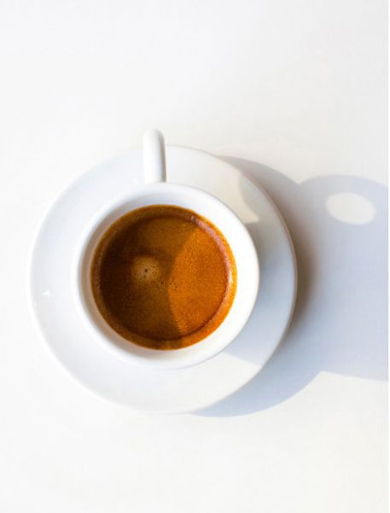

The coffee for people in the know -

Slide 2
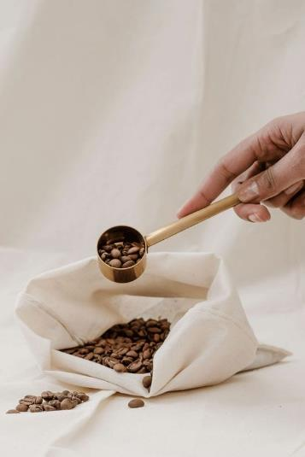
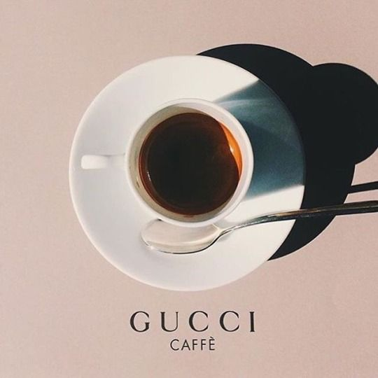


Brand Story -
We pour our heart and soul to bring you the perfect TARZA because like you, we have a discerning taste and a passion for perfection.
Our professional team of Q-graders handpicks the finest Arabica and Robusta beans across continents, putting through meticulous experimentations, checking off all the complex technical essentials to discover the perfect balance of sensory pleasure.
Through our sustainable Seed2C program, you can effortlessly trace back the stories of origins – from plantation, processing, to pouring at your home. Of precision and perfection, within those in the know. Each of our brews has its own story to tell, awaiting you to unveil and linger on its pleasurable aromas.
TARZA
Premium Coffee

Slide 3

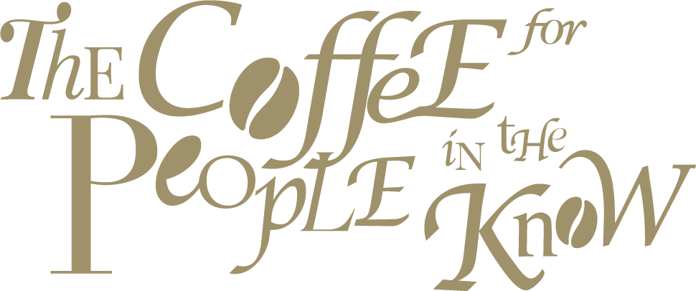

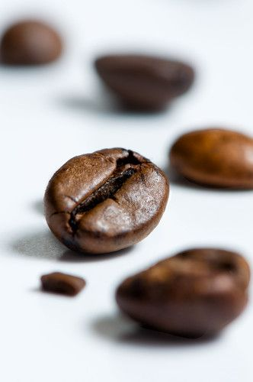
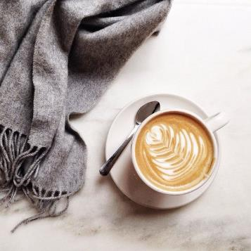
We know -
- The perfect cup for the people in the know
- A good combination of aroma, taste and texture for coffee lover
The golden formula of Italian espresso based coffee
The good cup of drip coffee for you

Slide 4
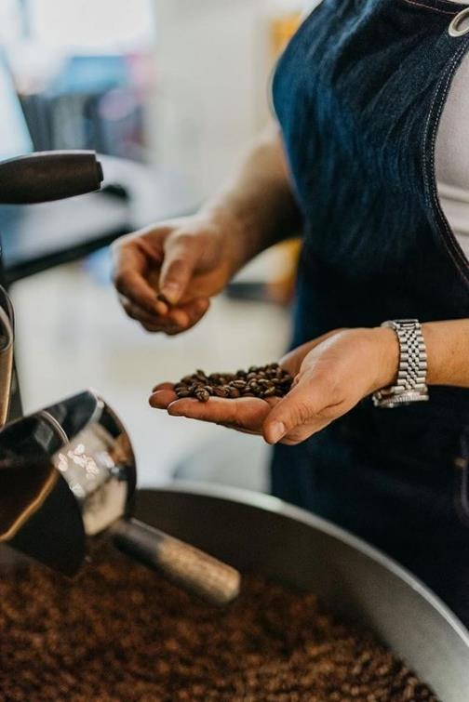
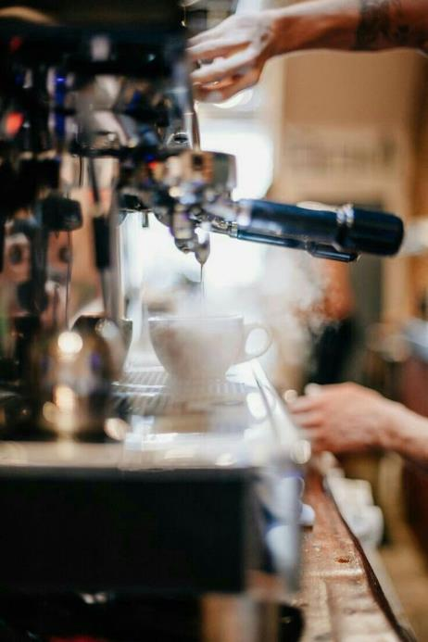
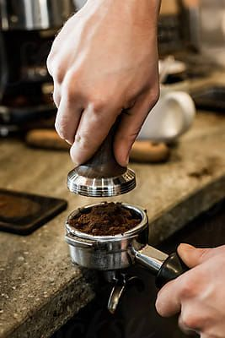
With 90-year-experience of coffee roasting,
so we understand -
The blend of coffee beans from all over the coffee belt with the good sourcing network
The professional R&D team on manipulate the best formula of blended beans with absolute right timing of roasting

Slide 5

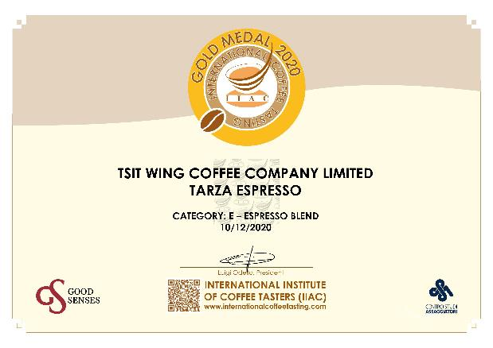

International Coffee Tasting – Gold Award 2020
This special award-wining blend took us months to experiment.
It gives the coffee a unique and colorful character, creating the perfect cup for the people addicted to coffee with an Italian profile.

Slide 6
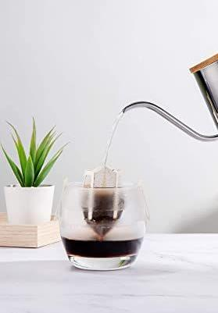
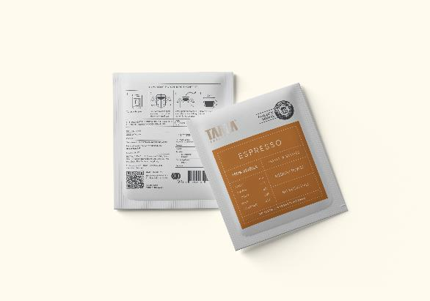
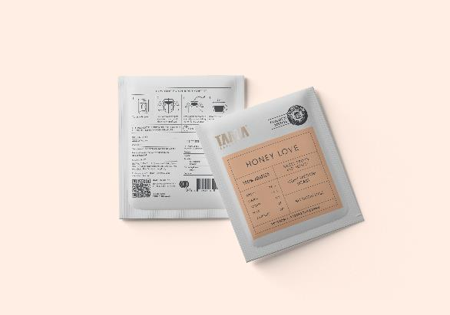
Take the good coffee with you everywhere -
Drip Coffee
Freshly roasted and perfect for a single serving.
Just add hot water to brew a fantastic coffee.
Espresso
Honey Love

Slide 7
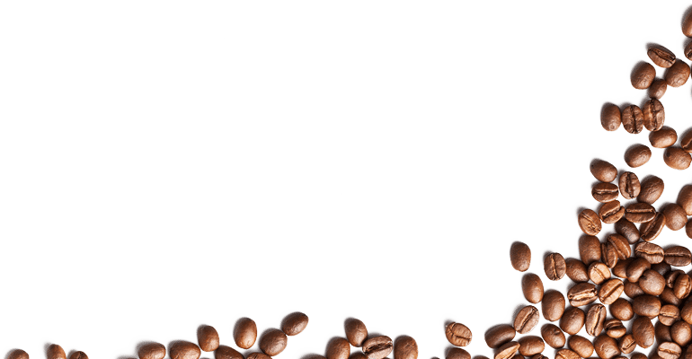
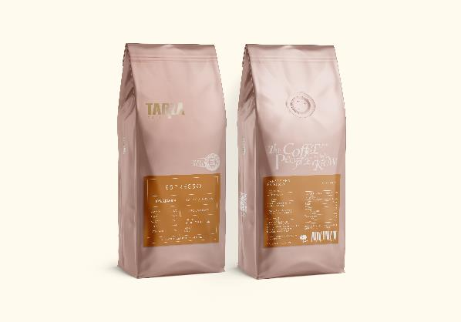
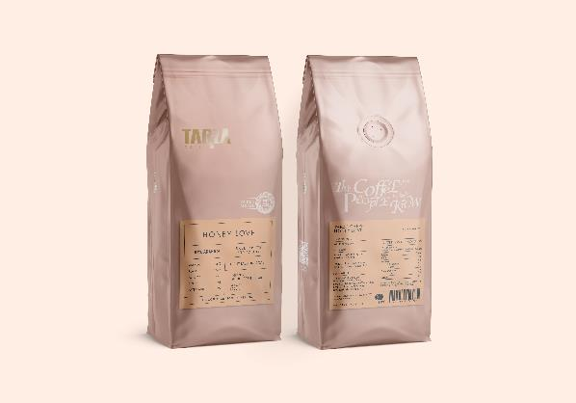
A dark, magical substance that turns you feel like in Italy
Roasted Coffee Bean
Open a bag of award-wining coffee beans, you can smell of cheerful day

Slide 8
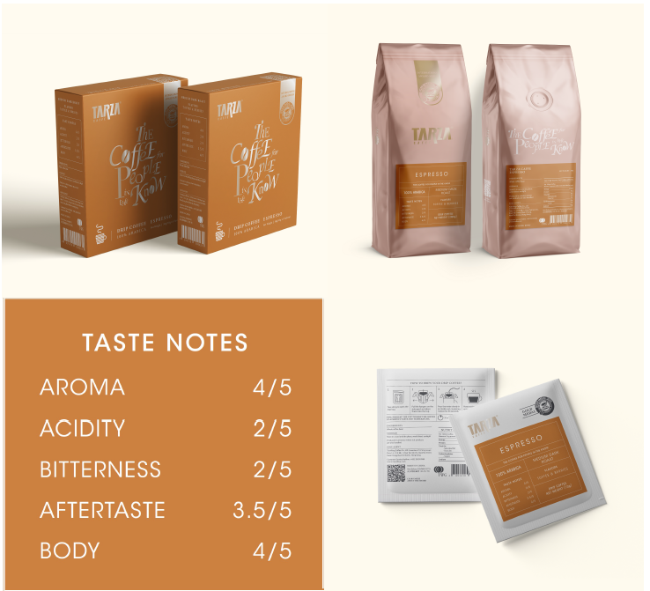
TARZA Espresso
Product Description -
TARZA Espresso is the ideal choice for those who enjoy the classic Italian aroma and persistent aftertaste.
The beans 100% Arabica carefully selected from Brazil, Colombia, Guatemala & Ethiopia; browned to create a coffee decided by the nots of toffee and berries.
The beans give an intense with a full body but silky texture.
Origins -
Brazil, Colombia, Guatemala & Ethiopia
Roasting Level -
Medium Dark

Slide 9
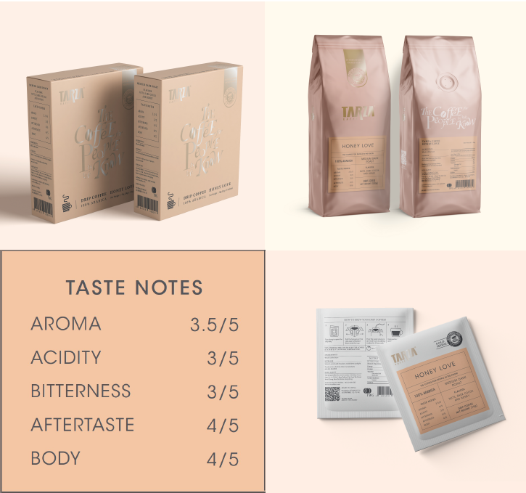
Honey Love
Product Description -
With a hint of sweet fruits and long lingering acidity, close your eyes and let his glossy smooth coffee warm your soul.
Honey Love is a harmonious blend of delicately selected Arabica beans from South America and Africa/
The honey-like sweetness and acidity make it telling its unique tale of heart felt feelings and the essence of love
Origins -
Brazil, Ethiopia & Rwanda
Roasting Level -
Medium Dark

Slide 10
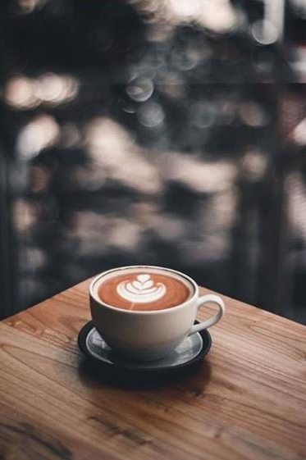
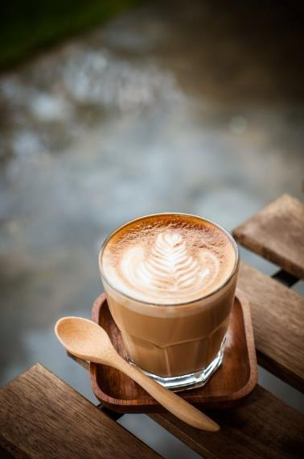
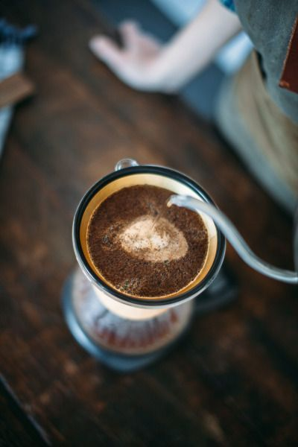
Thank you for enjoying our TARZA –

